Slide 1
Signal Processing I & II
Chul Min Yeum
Assistant Professor
Civil and Environmental Engineering
University of Waterloo, Canada
CIVE 497 – CIVE 700: Smart Structure Technology
Last updated: 2018-02-06

Slide 2
Reference
We will cover some key topics in Chapters 3 ~ 6 of the following reference:
Shin, K., & Hammond, J. K. (2008). Fundamentals of Signal Processing: for Sound and Vibration Engineers, John Wiley & Sons.
Chapter 3: Fourier Series
Chapter 4: Fourier Integrals (Fourier Transform) and Continuous-Time Linear Systems
Chapter 5: Time Sampling and Aliasing
Chapter 6: The Discrete Fourier Transform

Slide 3
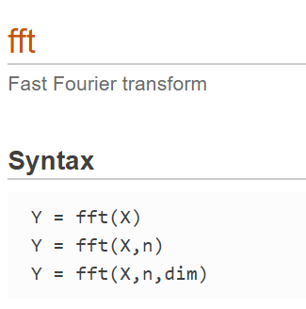
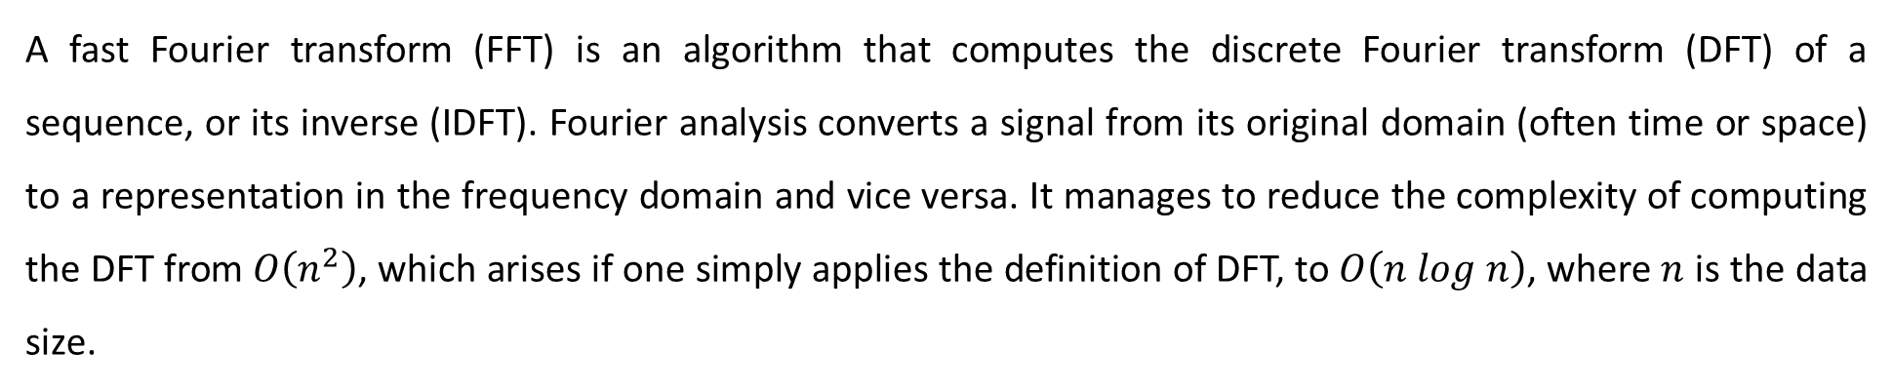
Fast Fourier Transform
A fast Fourier transform (FFT) is an algorithm that computes the discrete Fourier transform (DFT) of a sequence, or its inverse (IDFT). Fourier analysis converts a signal from its original domain (often time or space) to a representation in the frequency domain and vice versa. It manages to reduce the complexity of computing the DFT from $O\left(n^{2}\right)$, which arises if one simply applies the definition of DFT, to $O\left(n log n\right)$, where $n$ is the data size.
FFT in Matlab
Y = fft(X) computes the discrete Fourier transform (DFT) of X using a fast Fourier transform (FFT) algorithm
Y = fft(X,n) returns the n-point DFT. If no value is specified, Y is the same size as X.

Slide 4
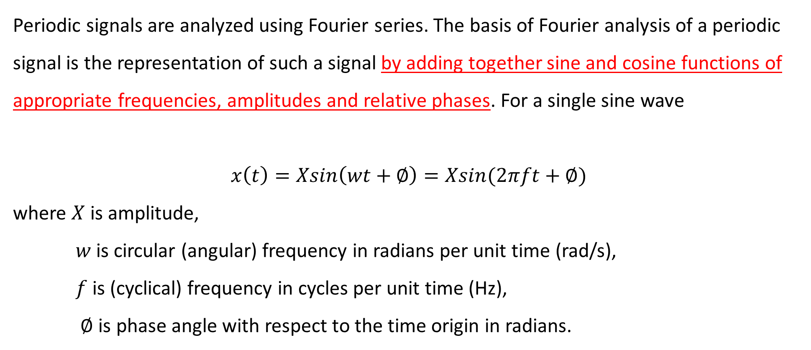
Periodic Signals and Fourier Series
Periodic signals are analyzed using Fourier series. The basis of Fourier analysis of a periodic signal is the representation of such a signal by adding together sine and cosine functions of appropriate frequencies, amplitudes and relative phases. For a single sine wave
$$x\left(t\right)=Xsin\left(wt+∅\right)=Xsin(2πft+∅)$$
where $X$ is amplitude,
$w$ is circular (angular) frequency in radians per unit time (rad/s),
$f$ is (cyclical) frequency in cycles per unit time (Hz),
$∅$ is phase angle with respect to the time origin in radians.

Slide 5
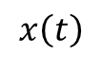
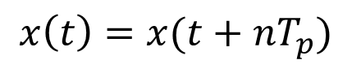
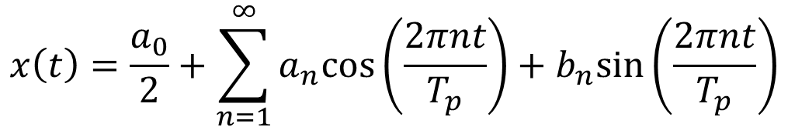
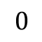
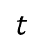
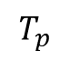
Fourier Series
A Fourier series is an expansion of a periodic function f(x) in terms of an infinite sum of sines and cosines. Fourier series make use of the orthogonality relationships of the sine and cosine functions. It decomposes any periodic function or periodic signal into the weighted sum of a (possibly infinite) set of simple oscillating functions, namely sines and cosines.
$$x\left(t\right)$$
$$x\left(t\right)=x(t+nT_{p})$$
$$t$$
$$0$$
$$T_{p}$$
$$x\left(t\right)=\frac{a_{0}}{2}+\sum_{n=1}^{∞}{a_{n}cos⁡\left(\frac{2πnt}{T_{p}}\right)+b_{n}sin⁡\left(\frac{2πnt}{T_{p}}\right)}$$

Slide 6
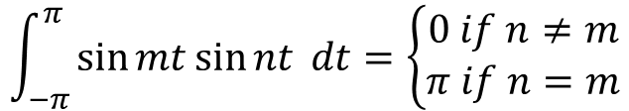
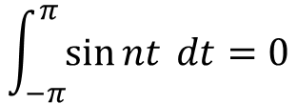
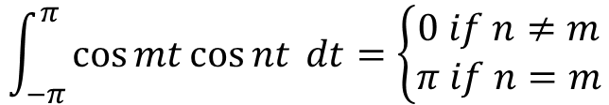
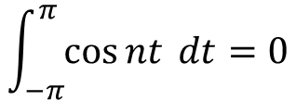
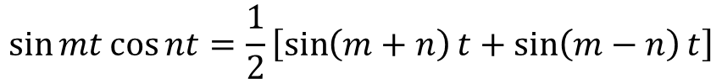
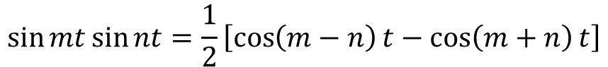
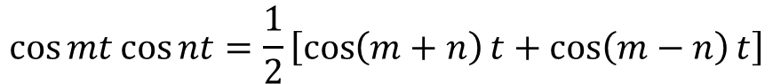
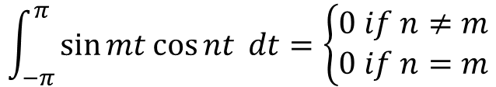
Basic Trigonometric Equations
$$\int_{−π}^{π}{\cos{nt} dt=0}$$
$$\int_{−π}^{π}{\sin{nt} dt=0}$$
Orthogonality of Trigonometric Functions
$$\int_{−π}^{π}{\cos{mt\cos{nt}} dt=\left\{\begin{matrix}0 if n≠m \\ π if n=m\end{matrix}\right.}$$
$$\cos{mt\cos{nt=\frac{1}{2}\left[\cos\left(m+n\right)t+\cos\left(m−n\right)t\right]}}$$
$$\int_{−π}^{π}{\sin{mt\sin{nt}} dt=\left\{\begin{matrix}0 if n≠m \\ π if n=m\end{matrix}\right.}$$
$$\sin{mt\sin{nt=\frac{1}{2}\left[\cos\left(m−n\right)t−\cos\left(m+n\right)t\right]}}$$
$$\int_{−π}^{π}{\sin{mt\cos{nt}} dt=\left\{\begin{matrix}0 if n≠m \\ 0 if n=m\end{matrix}\right.}$$
$$\sin{mt\cos{nt=\frac{1}{2}\left[\sin\left(m+n\right)t+\sin\left(m−n\right)t\right]}}$$

Slide 7
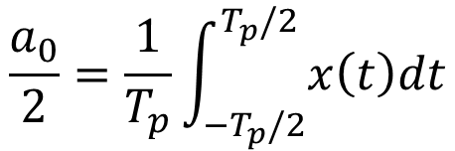
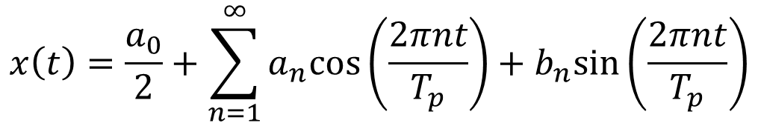
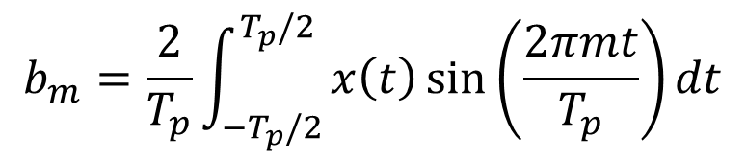
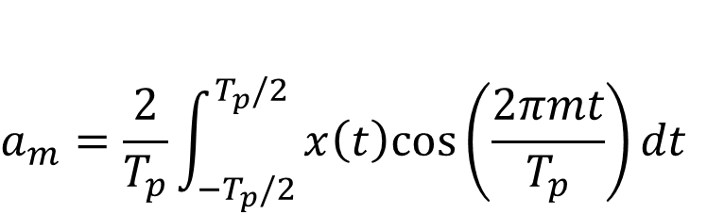
Fourier Coefficients
$$x\left(t\right)=\frac{a_{0}}{2}+\sum_{n=1}^{∞}{a_{n}cos⁡\left(\frac{2πnt}{T_{p}}\right)+b_{n}sin⁡\left(\frac{2πnt}{T_{p}}\right)}$$
$$\frac{a_{0}}{2}=\frac{1}{T_{p}}\int_{−T_{p}/2}^{T_{p}/2}{x\left(t\right)dt}$$
$$a_{m}=\frac{2}{T_{p}}\int_{−T_{p}/2}^{T_{p}/2}{x\left(t\right)cos⁡\left(\frac{2πmt}{T_{p}}\right)dt}$$
$$b_{m}=\frac{2}{T_{p}}\int_{−T_{p}/2}^{T_{p}/2}{x\left(t\right)\sin{⁡\left(\frac{2πmt}{T_{p}}\right)}dt}$$

Slide 8
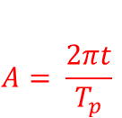
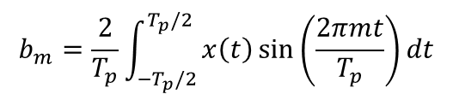
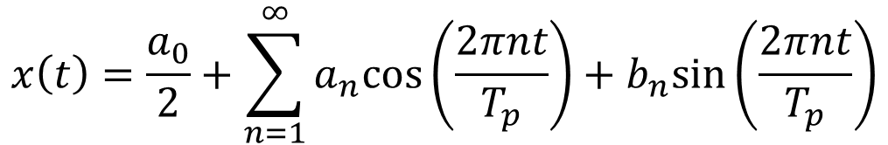

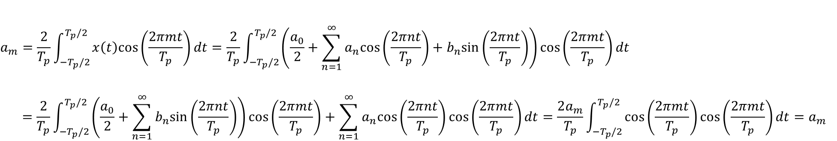

Fourier Coefficients (Continue)
$$x\left(t\right)=\frac{a_{0}}{2}+\sum_{n=1}^{∞}{a_{n}cos⁡\left(\frac{2πnt}{T_{p}}\right)+b_{n}sin⁡\left(\frac{2πnt}{T_{p}}\right)}$$
$$\frac{a_{0}}{2}=\frac{1}{T_{p}}\int_{0}^{T_{p}}{x\left(t\right)dt}=\frac{1}{T_{p}}\int_{−T_{p}/2}^{T_{p}/2}{x\left(t\right)dt}=\frac{a_{0}}{2}+\frac{1}{T_{p}}\int_{{−T}_{p}/2}^{T_{p}/2}{\sum_{n=1}^{∞}{a_{n}cos⁡\left(\frac{2πnt}{T_{p}}\right)+b_{n}sin⁡\left(\frac{2πnt}{T_{p}}\right)}dt}$$
$$0$$
$$a_{m}=\frac{2}{T_{p}}\int_{−T_{p}/2}^{T_{p}/2}{x\left(t\right)cos⁡\left(\frac{2πmt}{T_{p}}\right)dt}=\frac{2}{T_{p}}\int_{−T_{p}/2}^{T_{p}/2}{\left(\frac{a_{0}}{2}+\sum_{n=1}^{∞}{a_{n}cos⁡\left(\frac{2πnt}{T_{p}}\right)+b_{n}sin⁡\left(\frac{2πnt}{T_{p}}\right)}\right)cos⁡\left(\frac{2πmt}{T_{p}}\right)dt}$$
$$=\frac{2}{T_{p}}\int_{−T_{p}/2}^{T_{p}/2}{\left(\frac{a_{0}}{2}+\sum_{n=1}^{∞}{b_{n}sin⁡\left(\frac{2πnt}{T_{p}}\right)}\right)\cos\left(\frac{2πmt}{T_{p}}\right)+\sum_{n=1}^{∞}{a_{n}cos⁡\left(\frac{2πnt}{T_{p}}\right)}\cos\left(\frac{2πmt}{T_{p}}\right)dt}=\frac{2a_{m}}{T_{p}}\int_{−T_{p}/2}^{T_{p}/2}{\cos\left(\frac{2πmt}{T_{p}}\right)cos\left(\frac{2πmt}{T_{p}}\right)dt}=a_{m}$$
$$0$$
$$A= \frac{2πt}{T_{p}}$$
$$b_{m}=\frac{2}{T_{p}}\int_{−T_{p}/2}^{T_{p}/2}{x\left(t\right)\sin{⁡\left(\frac{2πmt}{T_{p}}\right)}dt}$$

Slide 9
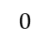
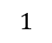
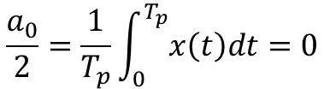
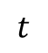
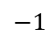
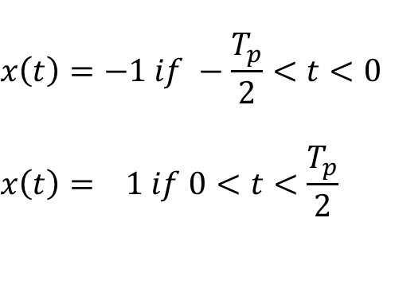
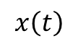
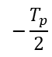
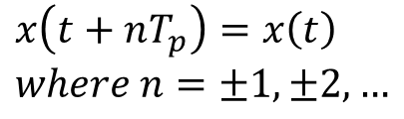
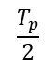
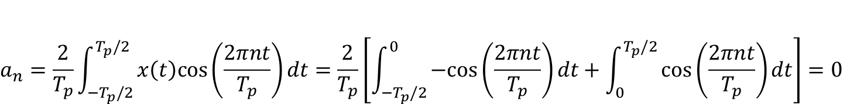
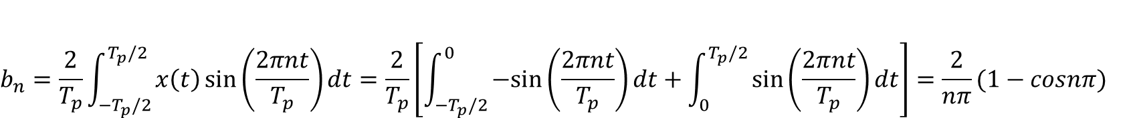
Example: Square Wave
$$x\left(t\right)=−1 if −\frac{T_{p}}{2}<t<0$$
$$x\left(t\right)= 1 if 0<t<\frac{T_{p}}{2}$$
$$x\left(t\right)$$
$$1$$
$$x\left(t+nT_{p}\right)=x\left(t\right)$$
$$where n=±1,±2, …$$
$$0$$
$$t$$
$$−\frac{T_{p}}{2}$$
$$\frac{T_{p}}{2}$$
$$−1$$
$$\frac{a_{0}}{2}=\frac{1}{T_{p}}\int_{0}^{T_{p}}{x\left(t\right)dt}=0$$
$$a_{n}=\frac{2}{T_{p}}\int_{−T_{p}/2}^{T_{p}/2}{x\left(t\right)cos⁡\left(\frac{2πnt}{T_{p}}\right)dt}=\frac{2}{T_{p}}\left[\int_{−T_{p}/2}^{0}{−cos⁡\left(\frac{2πnt}{T_{p}}\right)dt}+\int_{0}^{T_{p}/2}{cos⁡\left(\frac{2πnt}{T_{p}}\right)dt}\right]=0$$
$$b_{n}=\frac{2}{T_{p}}\int_{−T_{p}/2}^{T_{p}/2}{x\left(t\right)\sin{⁡\left(\frac{2πnt}{T_{p}}\right)}dt}=\frac{2}{T_{p}}\left[\int_{−T_{p}/2}^{0}{−sin⁡\left(\frac{2πnt}{T_{p}}\right)dt}+\int_{0}^{T_{p}/2}{sin⁡\left(\frac{2πnt}{T_{p}}\right)dt}\right]=\frac{2}{nπ}(1−cosnπ)$$

Slide 10
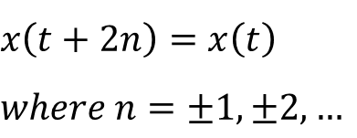
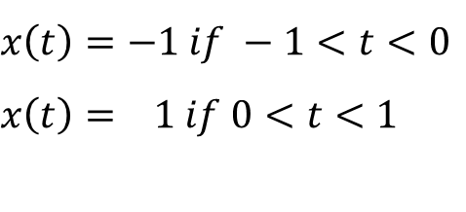
Example: Square Wave (Continue)
$$x\left(t\right)=−1 if −1<t<0$$
$$x\left(t\right)= 1 if 0<t<1$$
$$x\left(t+2n\right)=x\left(t\right)$$
$$where n=±1,±2, …$$

Slide 11
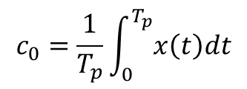
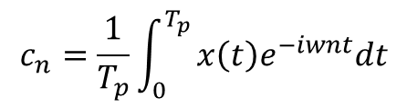
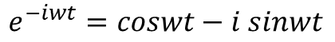
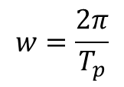
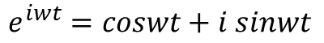
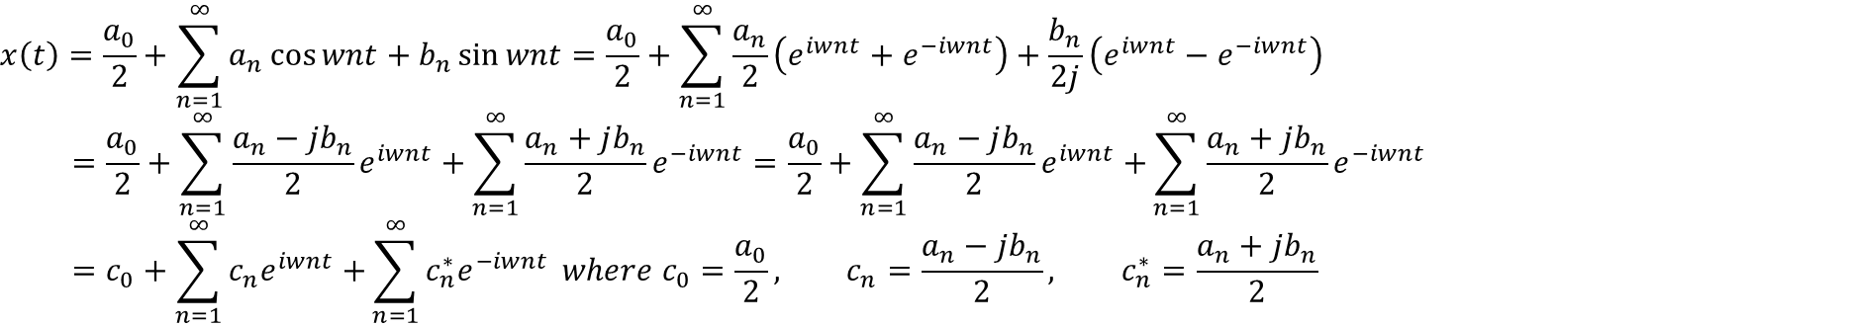
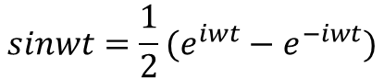
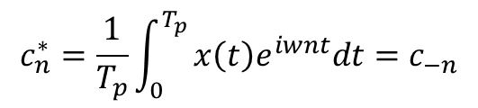
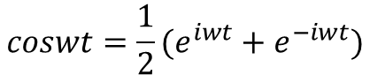
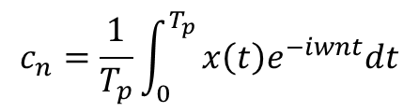
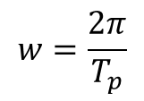
Complex Form of the Fourier Series
Euler Formula
$$coswt=\frac{1}{2}(e^{iwt}+e^{−iwt})$$
$$sinwt=\frac{1}{2}(e^{iwt}−e^{−iwt})$$
$$e^{iwt}=coswt+i sinwt$$
$$e^{−iwt}=coswt−i sinwt$$
$$x\left(t\right)=\frac{a_{0}}{2}+\sum_{n=1}^{∞}{a_{n}\cos{wnt}+b_{n}\sin{wnt}=\frac{a_{0}}{2}+\sum_{n=1}^{∞}{\frac{a_{n}}{2}\left(e^{iwnt}+e^{−iwnt}\right)+\frac{b_{n}}{2j}\left(e^{iwnt}−e^{−iwnt}\right)}}$$
$$=\frac{a_{0}}{2}+\sum_{n=1}^{∞}{\frac{a_{n}−jb_{n}}{2}e^{iwnt}+}\sum_{n=1}^{∞}{\frac{a_{n}+jb_{n}}{2}e^{−iwnt}}=\frac{a_{0}}{2}+\sum_{n=1}^{∞}{\frac{a_{n}−jb_{n}}{2}e^{iwnt}+}\sum_{n=1}^{∞}{\frac{a_{n}+jb_{n}}{2}e^{−iwnt}}$$
$$=c_{0}+\sum_{n=1}^{∞}{c_{n}e^{iwnt}+}\sum_{n=1}^{∞}{c_{n}^{∗}e^{−iwnt}} where c_{0}=\frac{a_{0}}{2}, c_{n}=\frac{a_{n}−jb_{n}}{2}, c_{n}^{∗}=\frac{a_{n}+jb_{n}}{2}$$
$$w=\frac{2π}{T_{p}}$$
$$c_{0}=\frac{1}{T_{p}}\int_{0}^{T_{p}}{x\left(t\right)dt}$$
$$c_{n}=\frac{1}{T_{p}}\int_{0}^{T_{p}}{x\left(t\right)e^{−iwnt}dt}$$
$$c_{n}^{∗}=\frac{1}{T_{p}}\int_{0}^{T_{p}}{x\left(t\right)e^{iwnt}dt}=c_{−n}$$
Negative frequency term ($c_{−n}$)
$$c_{n}=\frac{1}{T_{p}}\int_{0}^{T_{p}}{x\left(t\right)e^{−iwnt}dt}$$
$$w=\frac{2π}{T_{p}}$$
$$x\left(t\right)=\sum_{n=−∞}^{∞}{c_{n}e^{iwnt}}$$

Slide 12
Example: Square Wave (using the Complex Form)
$$x\left(t\right)=−1 if −1<t<0$$
$$x\left(t\right)= 1 if 0<t<1$$
$$x\left(t+2n\right)=x\left(t\right)$$
$$where n=±1,±2, …$$

Slide 13











Summary and Tutorials
$$x\left(t\right)$$
$$x\left(t\right)=x(t+nT_{p})$$
$$t$$
$$0$$
$$T_{p}$$
$$x\left(t\right)=\frac{a_{0}}{2}+\sum_{n=1}^{∞}{a_{n}cos⁡\left(\frac{2πnt}{T_{p}}\right)+b_{n}sin⁡\left(\frac{2πnt}{T_{p}}\right)}$$
General form
$$a_{m}=\frac{2}{T_{p}}\int_{−T_{p}/2}^{T_{p}/2}{x\left(t\right)cos⁡\left(\frac{2πmt}{T_{p}}\right)dt}$$
$$\frac{a_{0}}{2}=\frac{1}{T_{p}}\int_{−T_{p}/2}^{T_{p}/2}{x\left(t\right)dt}$$
$$b_{m}=\frac{2}{T_{p}}\int_{−T_{p}/2}^{T_{p}/2}{x\left(t\right)\sin{⁡\left(\frac{2πmt}{T_{p}}\right)}dt}$$
$$x\left(t\right)=\sum_{n=−∞}^{∞}{c_{n}e^{iwnt}}$$
$$c_{n}=\frac{1}{T_{p}}\int_{0}^{T_{p}}{x\left(t\right)e^{−iwnt}dt}$$
$$w=\frac{2πn}{T_{p}}$$
Complex form

Slide 14












Fourier Integral for Non-periodic Functions
$$c_{n}=\frac{1}{T_{p}}\int_{0}^{T_{p}}{x\left(t\right)e^{−iwnt}dt}$$
$$w=\frac{2π}{T_{p}}$$
$$x\left(t\right)=\sum_{n=−∞}^{∞}{c_{n}e^{iwnt}}$$
$$x\left(t\right)$$
The fundamental frequency$w=2π/T_{p}$ becomes smaller and smaller and all other frequencies ($nw=w_{n}$), being multiples of the fundamental frequency, are more densely packed on the frequency axis. Their separation is assumed to be$2π/T_{p}=∆w$. $∆w→0$ as $T_{p}→∞.$
$$t$$
$$T_{p}$$
$$x\left(t\right)$$
$$t$$
$$T_{p}$$
$$c_{n}=\lim_{\begin{aligned}T_{p}→∞ \\ ∆w→0\end{aligned}}{\frac{∆w}{2π}\int_{{−T}_{p}/2}^{T_{p}/2}{x\left(t\right)e^{−iw_{n}t}dt}}$$
$$x\left(t\right)$$
$$t$$
$$T_{p}$$

Slide 15






Fourier Integral for Non-periodic Functions (Continue)
$$c_{n}=\lim_{\begin{aligned}T_{p}→∞ \\ ∆w→0\end{aligned}}{\frac{∆w}{2π}\int_{{−T}_{p}/2}^{T_{p}/2}{x\left(t\right)e^{−iw_{n}t}dt}}$$
$$\lim_{∆w→∞}\left(\frac{c_{n}}{∆w}\right)=\lim_{∆w→∞}\left(\frac{1}{2π}\int_{{−T}_{p}/2}^{T_{p}/2}{x\left(t\right)e^{−iw_{n}t}dt}\right)$$
Assuming the limits exist, we write this as
$$X\left(w_{n}\right)=\frac{1}{2π}\int_{−∞}^{∞}{x\left(t\right)e^{−iw_{n}t}dt}$$
$$X\left(f_{n}\right)=\int_{−∞}^{∞}{x\left(t\right)e^{−i{2πf}_{n}t}dt}$$
Since $∆f→∞$, the frequencies $f_{n}$become a continuum, so we write $f$ instead of $f_{n}$.
$$X\left(f\right)=\int_{−∞}^{∞}{x\left(t\right)e^{−i2πft}dt}$$
Fourier integral or Fourier transform of $x\left(t\right)$

Slide 16




Fourier Integral for Non-periodic Functions (Continue)
$$x\left(t\right)=\sum_{n=−∞}^{∞}{c_{n}e^{i{2πf}_{n}t/T_{p}}}$$
$$\lim_{∆f→∞}\left(\frac{c_{n}}{∆f}\right)=X\left(f_{n}\right)$$
$x\left(t\right)$ can be rewritten as
$$x\left(t\right)=\lim_{∆f→∞}{\sum_{n=−∞}^{∞}{∆fX\left(f_{n}\right)e^{i{2πf}_{n}t/T_{p}}}}$$
which can be represented in a continuous form as
$$x(t)=\int_{−∞}^{∞}{X\left(f\right)e^{i2πft}df}$$
$$X\left(f\right)=\int_{−∞}^{∞}{x\left(t\right)e^{−i2πft}dt}$$

Slide 17











Comments on the Fourier Integral
1. $X\left(f\right)$ is complex and can be represented as
$$Im$$
$$X\left(f\right)$$
$$\left|X\left(f\right)\right|$$
$$X\left(f\right)=X_{Re}\left(f\right)+{i X}_{Im}\left(f\right)=\left|X\left(f\right)\right|e^{i∅(f)}$$
$$∅$$
$$Re$$
2. Fourier transformation using $f$and $w$
$$x(t)=\int_{−∞}^{∞}{X\left(f\right)e^{i2πft}df}$$
$$x(t)=\frac{1}{2π}\int_{−∞}^{∞}{X\left(w\right)e^{iwt}dw}$$
$$X\left(f\right)=\int_{−∞}^{∞}{x\left(t\right)e^{−i2πft}dt}$$
$$X\left(w\right)=\int_{−∞}^{∞}{x\left(t\right)e^{−iwt}dt}$$

Slide 18










Dirac Delta Function
The Dirac delta function is denoted by $δ(t)$
$δ\left(t\right)=0$ for $t≠0$, and $\int_{−∞}^{∞}{δ\left(t\right)dt}=1$
$$\frac{1}{ε}$$
$δ\left(t\right)=\frac{1}{ε}$ for $−\frac{ε}{2}<t<\frac{ε}{2}$
$=0$ otherwise
$δ\left(t\right)=∞$ for $t=0$
$=0$ otherwise
$$−\frac{ε}{2}$$
$$\frac{ε}{2}$$
$$t$$
Properties
Proof:
$$\int_{−∞}^{∞}{x(t)δ\left(t−a\right)dt}=x(a)$$
$$\int_{−∞}^{∞}{e^{±i2πat}dt}=\lim_{M→∞}\left(\int_{−M}^{M}{\left(cos2πat±i sin2πat\right)dt}\right)$$
$$=\lim_{M→∞}\left(\int_{−M}^{M}{\left(cos2πat\right)dt}\right)=\lim_{M→∞}{\left.2\frac{sin2πat}{2πa}\right|}_{0}^{M}$$
$$=\lim_{M→∞}2M\frac{sin2πaM}{2πaM}=δ(a)$$
$$\int_{−∞}^{∞}{e^{±i2πat}dt}=δ(a)$$
Sinc function

Slide 19

Sinc Function
$$sinc(x)≡\left\{\begin{matrix} 1 for x=0 \\ \frac{\sin{Mx}}{Mx} otherwise\end{matrix}\right.$$

Slide 20

Table of Fourier Transform Pairs

Slide 21







Example: Dirac Delta Function
$δ\left(t\right)=∞$ for $t=0$
$=0$ otherwise
$$X\left(f\right)=\int_{−∞}^{∞}{δ\left(t\right)e^{−i2πft}dt}=e^{−i2πf∙0}=1$$
$$δ(t)$$
$$X(f)$$
$$1.0$$
$$t$$
$$f$$

Slide 22

Example: Exponentially Decaying Symmetric Function
$$x\left(t\right)=e^{−λ\left|t\right|}, λ>0$$
$$X\left(f\right)=\int_{−∞}^{∞}{x(t)e^{−i2πft}dt}=\int_{−∞}^{∞}{e^{−λ\left|t\right|}e^{−i2πft}dt}$$
$$=\int_{−∞}^{0}{e^{λt}e^{−i2πft}dt}+\int_{0}^{∞}{e^{−λt}e^{−i2πft}dt}=\frac{2λ}{λ^{2}+4π^{2}f^{2}}$$

Slide 23




Example: Exponentially Decaying Symmetric Function (Continue)
$$X\left(f\right)=\frac{2λ}{λ^{2}+4π^{2}f^{2}}$$
$$x\left(t\right)=e^{−λ\left|t\right|}, λ>0$$
$$X\left(0\right)=\frac{2λ}{λ^{2}}=\frac{2}{λ}$$
$$X\left(\frac{λ}{2π}\right)=\frac{2λ}{λ^{2}+λ^{2}}=\frac{1}{λ}=\frac{X\left(0\right)}{2}$$
if $λ$ is large then $X(f)$ is narrow in the time domain, but wide in the frequency domain and vice versa. This is an example of the so-called inverse spreading property of the Fourier transform, i.e. the wider in one domain, then the narrower in the other.

Slide 24











Example: Sine Function
$$x\left(t\right)=A\sin{2πpt}$$
$$X\left(f\right)=\int_{−∞}^{∞}{x(t)e^{−i2πft}dt}=\int_{−∞}^{∞}{A\sin{2πpt}e^{−i2πft}dt}=\int_{−∞}^{∞}{\frac{A}{2i}(e^{i2πpt}−e^{−i2πpt})e^{−i2πft}dt}=\frac{A}{2i}\int_{−∞}^{∞}{ (e^{−i2π(f−p)t}−e^{−−i2π(f+p)t}) dt}=\frac{A}{2i}\left[δ\left(f−p\right)−δ\left(f+p\right)\right]$$
$$\left|X(f) \right|$$
$$x(t)$$
$$A$$
$$A/2$$
$$A/2$$
$$t$$
$$−p$$
$$p$$
$$f$$
$$1/p$$

Slide 25


Example: Rectangular Function
$x\left(t\right)=a$ for $\left|t\right|<$b
$=0$ for $\left|t\right|>$b
$$X\left(f\right)=\int_{−∞}^{∞}{x\left(t\right)e^{−i2πft}dt}=\int_{−b}^{b}{ae^{−i2πft}dt=\frac{2ab\sin{2πfb}}{2πfb}}$$
See Sinc function

Slide 26

Example: Damped Symmetrically Oscillating Function
$$x\left(t\right)=e^{−a\left|t\right|}cos2πf_{0}t$$
$$X\left(f\right)=\int_{−∞}^{∞}{x(t)e^{−i2πft}dt}=\int_{−∞}^{∞}{e^{−a\left|t\right|}cos2πf_{0}t e^{−i2πft}dt}=\int_{−∞}^{∞}{e^{−a\left|t\right|}\frac{1}{2}(e^{i2πf_{0}t}+e^{−i2πf_{0}t})e^{−i2πft}dt}$$
$$=\frac{1}{2}\int_{−∞}^{∞}{e^{−a\left|t\right|}(e^{−i2π\left(f−f_{0}\right)t}+e^{−i2π(f+f_{0})t}) dt}=\frac{a}{a^{2}+{\left[2π\left(f−f_{0}\right)\right]}^{2}}+\frac{a}{a^{2}+{\left[2π\left(f+f_{0}\right)\right]}^{2}}$$
convolution

Slide 27

Example: Ultrasonic-based Damage Detection
https://www.sciencedirect.com/science/article/pii/S0165212511000102
https://www.sciencedirect.com/science/article/pii/S0886779809001266

Slide 28




Gaussian Function
$$f\left(x\right)=ae^{−\frac{{\left(x−b\right)}^{2} }{2c^{2}}}$$
$$g\left(x\right)=\frac{1}{σ\sqrt{2π}}e^{−\frac{1}{2}{\left(\frac{x−u}{σ}\right)}^{2}}$$
$$\int_{−∞}^{∞}{f\left(x\right)dx=\int_{−∞}^{∞}{ae^{−\frac{{\left(x−b\right)}^{2} }{2c^{2}}}dx=}}\sqrt{2π}a\left|c\right|$$

Slide 29

Example: Gaussian Function
$$x\left(t\right)=e^{−at^{2}}$$
$$X\left(w\right)=\int_{−∞}^{∞}{x(t)e^{−iwt}dt}=\int_{−∞}^{∞}{e^{−at^{2}}e^{−iwt}dt}=\int_{−∞}^{∞}{e^{−a(t^{2}+\frac{iwt}{a})}dt}=e^{−\frac{w^{2}}{4a}}\int_{−∞}^{∞}{e^{−a(t^{2}+\frac{iwt}{a}−\frac{w^{2}}{4a})}dt}$$
$$=e^{−\frac{w^{2}}{4a}}\int_{−∞}^{∞}{e^{−a{\left(t+i\left(\frac{w}{2a}\right)\right)}^{2}}dt}=e^{−\frac{w^{2}}{4a}}\int_{−∞}^{∞}{e^{−ay^{2}}dy}=\sqrt{π/a}{∙e}^{−\frac{w^{2}}{4a}}$$

Slide 30


Example: Fourier Transform of a Periodic Function
$$x\left(t\right)=\sum_{n=−∞}^{∞}{c_{n}e^{i2πnt/T_{p}}}$$
$$X\left(f\right)=\int_{−∞}^{∞}{\sum_{n=−∞}^{∞}{c_{n}e^{i2πnt/T_{p}}}e^{−i2πft}dt}=\sum_{n=−∞}^{∞}{\int_{−∞}^{∞}{c_{n}e^{i2π\left(f−\frac{n}{T_{p}}\right)t}dt=\sum_{n=−∞}^{∞}{\int_{−∞}^{∞}{c_{n}δ(f−\frac{n}{T_{p}})dt}}}}$$
Fourier transform of a periodic function is a series of delta functions scaled by $c_{n}$, and located at multiples of the fundamental frequency, $1/T_{p}$.

Slide 31






Properties of Fourier Transforms
1. Time scaling
2. Time reversal
$$F\left(x\left(at\right)\right)=\frac{1}{\left|a\right|}X(\frac{f}{a})$$
$$F\left(x\left(−t\right)\right)=X(−f)$$
3. Differentiation
Inverse spreading relationship
5. Modulation
$$F\left(\dot{x}\left(t\right)\right)=i2πfX(f)$$
$$F\left(x\left(t\right)e^{i2πf_{0}t}\right)=X(f−f_{0})$$
4. Time shifting
$$F\left(x\left(t\right)cos⁡(2πf_{0}t) \right)=\frac{1}{2}\left[X\left(f−f_{0}\right) +X(f+f_{0}) \right]$$
$$F\left(x\left(t−t_{0}\right)\right)=e^{−i2πft_{0}}X(f)$$
Only phase shift !
Sine wave
wifi

Slide 32

(Off-Topic) How Dose Modulation Work?
https://www.taitradioacademy.com/topic/how-does-modulation-work-1-1/

Slide 33

Properties of Fourier Transforms (Convolution)
$$F\left(h\left(t\right)∗x(t)\right)=H\left(f\right)X(f)$$
Where the convolution of the two functions h(t) and x(t) is defined as
$$h\left(t\right)∗x(t)=\int_{−∞}^{∞}{h\left(τ\right)x(t−τ)dτ}$$
Notes:
Signal processing
Image processing
Machine learning

Slide 34


Example: Convolution 1
$$h\left(t\right)x(t)$$
$$h\left(t\right)∗x(t))=\int_{−∞}^{∞}{h\left(τ\right)x(t−τ)dτ}$$

Slide 35


Convolution (Visualization)
$$h\left(t\right)∗x(t)=\int_{−∞}^{∞}{h\left(τ\right)x(t−τ)dτ}$$
http://lpsa.swarthmore.edu/Convolution/CI.html

Slide 36

Proof of Convolution Relationship
$$F\left(h\left(t\right)∗x\left(t\right)\right)=\int_{−∞}^{∞}{\int_{−∞}^{∞}{h\left(τ\right)x\left(t−τ\right)\exp^{−i2πft}{dτ}}dt}=\int_{−∞}^{∞}{\int_{−∞}^{∞}{h\left(τ\right)x\left(v\right)\exp^{−i2πf(τ+v)}{dτ}}dv}=\int_{−∞}^{∞}{h\left(τ\right)\exp^{−i2πf(τ)}{dτ}}\int_{−∞}^{∞}{x\left(v\right)\exp^{−i2πf(v)}{dv}}=H\left(f\right)X(f)$$

Slide 37

Properties of Fourier Transforms (Convolution) (Continue)
$$F\left(x\left(t\right)w(t)\right)=\int_{−∞}^{∞}{X\left(g\right)W\left(f−g\right)dg}=X\left(f\right)∗W(f)$$
$$F\left(x\left(t\right)w(t)\right)=\int_{−∞}^{∞}{\int_{−∞}^{∞}{\int_{−∞}^{∞}{X\left(f_{1}\right)\exp^{i2πf_{1}t}{W\left(f_{2}\right)\exp^{i2πf_{2}t}\exp^{−i2πft}{df_{1}}}}df_{2}}dt}=\int_{−∞}^{∞}{X\left(f_{1}\right)\int_{−∞}^{∞}{W\left(f_{2}\right)\int_{−∞}^{∞}{\exp^{−i2π(f−f_{1}−f_{2})t}{\operatorname{dt}{df_{2}}}}df_{1}}}$$
$$=\int_{−∞}^{∞}{X\left(f_{1}\right)\int_{−∞}^{∞}{W\left(f_{2}\right)δ(f−f_{1}−f_{2})df_{2}df_{1}}=\int_{−∞}^{∞}{X\left(f_{1}\right)W\left(f−f_{1}\right)df_{1}}=X\left(f\right)∗W(f) }$$

Slide 38






Example: Convolution 2
$$\left|X(f) \right|$$
$$A/2$$
$$A/2$$
$$−p$$
$$p$$
$$f$$
$$x\left(t\right)=e^{−a\left|t\right|}cos2πf_{0}t$$

Slide 39





Effect of Data Truncation (Windowing)
$$x(t)$$
$$w(t)$$
$w\left(t\right)=1$ for $\left|t\right|<$T/2
$=0$ otherwise
$$t$$
$x(t)$ is known (or recorded) only for $−\frac{T}{2}<t<\frac{T}{2}$, denoted as $x_{T}(t)$
$$x_{T}\left(t\right)=x\left(t\right)w\left(t\right)=X\left(f\right)∗W(f)$$
Fourier transform of the product of two time signals is the convolution of their Fourier transforms.

Slide 40













Effect of Data Truncation (Windowing) (Continue)
$$X\left(f\right)=\frac{A}{2}\left[δ\left(f−p\right)−δ\left(f+p\right)\right]$$
$$x\left(t\right)=A\cos{2πpt}$$
$$W\left(f\right)=\frac{T\sin{πfT}}{πfT}$$
$$w\left(t\right)=1$$
$$X(f)$$
$$X_{T}(f)$$
$$A/2$$
$$A/2$$
$$−p$$
$$p$$
$$W(f)$$
$$−p$$
$$p$$
$$T$$
$$1/T$$
Smearing: Distortion due to the main lobe
Leakage: Distortion due to the side lobe
Notes:
https://stackoverflow.com/questions/31131672/difference-between-mean-and-gaussian-filter-in-result
https://community.plm.automation.siemens.com/t5/Testing-Knowledge-Base/Introduction-to-Filters-FIR-versus-IIR/ta-p/520959
https://electronics.stackexchange.com/questions/109820/why-should-i-use-digital-filters-for-bandpassing-rather-than-simply-manipulate-s
https://dsp.stackexchange.com/questions/6220/why-is-it-a-bad-idea-to-filter-by-zeroing-out-fft-bins

Slide 41















Effect of Data Truncation (Windowing) (Continue)
$$\left|X(f) \right|$$
$x(t)$ is the sum of three sine (or cosine) waves
$$f_{0}$$
$$f_{1}$$
$$f_{2}$$
$$\left|X(f) \right|$$
$T_{p}$ Increase
Considerable smearing due to the spectral window
$$f_{0}$$
$$f_{1}$$
$$f_{2}$$
$$\left|X(f) \right|$$
Three components are resolved but with considerable leakage at other frequencies
$$f_{0}$$
$$f_{1}$$
$$f_{2}$$

Slide 42



Window Function
Notes:
https://en.wikipedia.org/wiki/Window_function
https://www.bksv.com/media/doc/bo0436.pdf

Slide 43
Signal Smoothing Example
https://www.mathworks.com/help/signal/examples/signal-smoothing.html

Slide 44

Hanning Window vs Rectangular Window
$$x\left(t\right)=A_{1}\sin{2πf_{1}t+A_{2}sin2{πf}_{2}t}+A_{3}sin2πf_{3}t$$

Slide 45


Hanning Window vs Rectangular Window (Continue)
$$T_{p}=0.6$$
$$T_{p}=1$$

Slide 46


Hanning Window vs Rectangular Window (Continue)
$$T_{p}=2$$
$$T_{p}=4$$

Slide 47














Impluse Train Modulation
A ‘train’ of delta functions $i\left(t\right)$is expressed as
$$i(t)$$
$$i\left(t\right)=\sum_{n=−∞}^{∞}{δ(t−n∆)}$$
$$Δ$$
$$t$$
The sampling procedure can be illustrated as
$$x_{s}\left(t\right)=x\left(t\right)i\left(t\right)$$
$$x(t)$$
$$i(t)$$
$$x_{s}(t)$$
$$×$$
$$=$$
$$t$$
$$t$$
$$t$$
$$X_{s}\left(f\right)=\int_{−∞ }^{∞ }{\left[x(t)\sum_{n=−∞}^{∞}{δ(t−n∆)}\right]e^{−i2πft}dt}=\sum_{n=−∞}^{∞}{\left[\int_{−∞ }^{∞ }{{x(t)e}^{−i2πft}δ(t−n∆)dt}\right]=\sum_{n=−∞}^{∞}{x(n∆)e^{−i2πfn∆}}}$$
Notes:
https://dsp.stackexchange.com/questions/45821/what-is-the-product-of-dirac-delta-function-and-t

Slide 48



Impluse Train Modulation (Continue)
$$X_{s}\left(f+r/∆\right)=\sum_{n=−∞}^{∞}{x(n∆)e^{−i2π(f+r/∆)n∆}}=\sum_{n=−∞}^{∞}{x(n∆)e^{−i2πfn∆−i2πrn}}=\sum_{n=−∞}^{∞}{x\left(n∆\right)e^{−i2πfn∆}=X_{s}(f)}$$
$$X_{s}\left(f\right)=\sum_{n=−∞}^{∞}{x(n∆)e^{−i2πfn∆}}$$
Multiplying both sides of equation by $e^{−i2πfr∆}$ and integrating w.r.t $f$
$$\int_{−1/2∆}^{1/2∆}{X_{s}(f)e^{−i2πfr∆}df}=\int_{−1/2∆}^{1/2∆}{\left[\sum_{n=−∞}^{∞}{x\left(n∆\right)e^{−i2πfn∆}}\right]e^{−i2πfr∆}df}=\sum_{n=−∞}^{∞}{\int_{−1/2∆}^{1/2∆}{\left[x\left(n∆\right)e^{−i2πfn∆}\right]e^{−i2πfr∆}df}}=\sum_{n=−∞}^{∞}{x\left(n∆\right)\int_{−1/2∆}^{1/2∆}{\left[e^{−i2πf(n−r)∆}\right]df}=}x\left(r∆\right)\frac{1}{∆}$$
Use L'Hôpital's rule
$$X_{s}(f)=\sum_{n=−∞}^{∞}{x(n∆)e^{−i2πfn∆}}$$
$$x\left(n∆\right)=∆ \int_{−1/2∆}^{1/2∆}{X_{s}(f)e^{i2πfn∆}df}$$

Slide 49





Link Between Fourier Transform of a Discrete Sequence and Continuous Signal
Fourier coefficients
$$x\left(t\right)=\sum_{n=−∞}^{∞}{c_{n}e^{i2πnt/T_{p}}}$$
$$c_{n}=\frac{1}{T_{p}}\int_{0}^{T_{p}}{x\left(t\right)e^{−i2πnt/T_{p}}dt}$$
Impluse train
$$i\left(t\right)=\sum_{n=−∞}^{∞}{δ(t−n∆)}$$
$$c_{n}=\frac{1}{∆}\int_{−1/∆}^{1/∆}{\sum_{n=−∞}^{∞}{δ(t−n∆)}e^{−i2πnt/∆}dt}=\frac{1}{∆}\int_{−1/∆}^{1/∆}{e^{−i2πnt/∆}dt}=\frac{1}{∆}$$
Fourier Transform of the impulse train
$$I\left(f\right)=F\left(i\left(t\right)\right)=\int_{−∞}^{∞}{\sum_{n=−∞}^{∞}{\frac{1}{∆}e^{\frac{i2πnt}{∆}}}∙e^{−i2πft}dt=\frac{1}{∆}\sum_{n=−∞}^{∞}{\int_{−∞}^{∞}{e^{\frac{i2πnt}{∆}}{∙e}^{−i2πft}dt=\frac{1}{∆}\sum_{n=−∞}^{∞}{\int_{−∞}^{∞}{e^{−i2π\left(f−\frac{n}{∆}\right)t}dt}}}}}=\frac{1}{∆}\sum_{n=−∞}^{∞}{δ(f−\frac{n}{∆})}$$

Slide 50



Link Between Fourier Transform of a Discrete Sequence and Continuous Signal (Continue)
Fourier Transform of a discrete sequence, $x_{s}(t)$
$$X_{s}\left(f\right)=I\left(f\right)∗X\left(f\right)=\int_{−∞ }^{∞ }{I\left(g\right)X\left(f−g\right)dg}=\int_{−∞ }^{∞ }{\frac{1}{∆}\sum_{n=−∞}^{∞}{δ\left(g−\frac{n}{∆}\right)}X\left(f−g\right)dg}=\frac{1}{∆}\sum_{n=−∞}^{∞}{\int_{−∞ }^{∞ }{δ\left(g−\frac{n}{∆}\right)}X\left(f−g\right)dg }=\frac{1}{∆}\sum_{n=−∞}^{∞}{X\left(f−\frac{n}{∆}\right)}=\frac{1}{∆}\left(…+X\left(f−\frac{2}{∆}\right)+X\left(f−\frac{1}{∆}\right)+X\left(f\right)+X\left(f+\frac{1}{∆}\right)+ …\right)$$

Slide 51





Discrete Fourier Transform
So far we have considered sequences that run over the range −∞ < n < ∞(n integer). For the special case where the sequence is of finite length (i.e. non-zero for a finite number of values) an alternative Fourier representation is possible called the discrete Fourier transform (DFT).
It turns out that the DFT is a Fourier representation of a finite length sequence and is itself a sequence rather than a continuous function of frequency, and it corresponds to samples, equally spaced in frequency, of the Fourier transform of the signal. The DFT is fundamental to many digital signal processing algorithms.
$$X_{s}(f)=\sum_{n=−∞}^{∞}{x(n∆)e^{−i2πfn∆}}$$
Continuous in frequency
Repeated every 1/ $∆$
$$X(k)=\sum_{n=0}^{N−1}{x(n)e^{−i\frac{2π}{N}nk}}$$
$$f=\frac{k}{N∆}$$
DFT of a finite (sampled) sequence $x(n∆)$
$X\left(k\right)$ is $X_{s}(f)$ evaluated at $f=\frac{k}{N∆}$ Hz ($k$ integer)
$$x(n)=\frac{1}{N}\sum_{n=0}^{N−1}{X(k)e^{i\frac{2π}{N}nk}}$$
Inverse DFT
Notes:
https://dsp.stackexchange.com/questions/10293/zero-padding-in-fft
https://www.mathworks.com/matlabcentral/answers/364256-in-the-fft-example-on-matlab-help-why-do-we-multiply-by-2

Slide 52
Fast Fourier Transform
A fast Fourier transform (FFT) is an algorithm that computes the discrete Fourier transform (DFT) of a sequence, or its inverse (IDFT). Fourier analysis converts a signal from its original domain (often time or space) to a representation in the frequency domain and vice versa. It manages to reduce the complexity of computing the DFT from $O\left(n^{2}\right)$, which arises if one simply applies the definition of DFT, to $O\left(n log n\right)$, where $n$ is the data size.
FFT in Matlab
Y = fft(X) computes the discrete Fourier transform (DFT) of X using a fast Fourier transform (FFT) algorithm
Y = fft(X,n) returns the n-point DFT. If no value is specified, Y is the same size as X.

Slide 53

Zero-Padding
Y = fft(X, n) returns the n-point DFT. If no value is specified, Y is the same size as X.
If X is a vector and the length of X is less than n, then X is padded with trailing zeros to length n.
If X is a vector and the length of X is greater than n, then X is truncated to length n.
$$X(k)=\sum_{n=0}^{N−1}{x(n)e^{−i\frac{2π}{N}nk}}$$
$X\left(k\right)$ is $X_{s}(f)$ evaluated at $f=\frac{k}{N∆}$ Hz
frequency spacing $\frac{1}{N∆}$ Hz

Slide 54


Zero-Padding (Continue)
$\hat{x}\left(t\right)=x(n)$ for $0≤n≤N−1$
$=0 \text{for} N≤n≤L−1$
$$\hat{X}(k)=\sum_{n=0}^{L−1}{\hat{x}\left(n\right)e^{−i\frac{2π}{L}nk}=}\sum_{n=0}^{N−1}{x\left(n\right)e^{−i\frac{2π}{L}nk}}$$
“Finer” spacing in the frequency domain. However, the zero padding does not increase the “true” resolution.
Vibration problems, this can be used to obtain the fine detail near resonances
See the slide of “effect of data truncation”

Slide 55
Example: Zero-Padding

Slide 56





Example: FFT
https://www.mathworks.com/help/matlab/ref/fft.html
FFTOfNoisySignalExample_course.mlx
Repeated every 1/ $∆$
$$X(k)=\sum_{n=0}^{N−1}{x(n)e^{−i\frac{2π}{N}nk}}$$
$$f=\frac{k}{N∆}$$
DFT of a finite (sampled) sequence $x(n∆)$
$X\left(k\right)$ is $X_{s}(f)$ evaluated at $f=\frac{k}{N∆}$ Hz ($k$ integer)
$$\hat{X}(k)=\sum_{n=0}^{L−1}{\hat{x}\left(n\right)e^{−i\frac{2π}{L}nk}=}\sum_{n=0}^{N−1}{x\left(n\right)e^{−i\frac{2π}{L}nk}}$$
$$f_{1}=\frac{k}{L∆}$$
$\hat{x}\left(t\right)=x(n)$ for $0≤n≤N−1$
$=0 \text{for} N≤n≤L−1$
Notes:
https://www.mathworks.com/matlabcentral/answers/364256-in-the-fft-example-on-matlab-help-why-do-we-multiply-by-2

Slide 57
Understanding of Zero-Padding
Zero-padding data for a longer FFT is equivalent to interpolation by a (periodic) Sinc kernel. Interpolation by a (periodic) Sinc kernel can reconstruct points between samples of a signal that was strictly bandlimited (to below the Nyquist frequency) prior to sampling.
Notes:
https://dsp.stackexchange.com/questions/34938/does-zero-padding-work-as-advertised
https://dsp.stackexchange.com/questions/11560/why-do-we-say-that-zero-padding-doesnt-really-increase-frequency-resolution

